Slide 1
18ECC203J – Module 1 Intel 8086 – Architecture, Signals and Features S – 13
Prepared by,
Dr. R. Manohari
Dr.T.Rajalakshmi

Slide 2
S – 13 Intel 8088 Microprocessor: Pins signals and Architecture & Differences between 8086 & 8088 microprocessors

Slide 3
8086 and 8088 Microprocessors
8086 announced in 1978; 8086 is a 16 bit microprocessor with a 16 bit data bus
8088 announced in 1979; 8088 is a 16 bit microprocessor with an 8 bit data bus
Both manufactured using High-performance Metal Oxide Semiconductor (HMOS) technology
Both contain about 29000 transistors
Both are packaged in 40 pin dual-in-line package (DIP)
Address lines A0-A7 and Data lines D0-D7 are multiplexed in 8088 –By multiplexed we mean that the same physical pin carries an address bit at one time and the data bit another time
Address lines A0-A15 and Data lines D0-D15 are multiplexed in 8086

Slide 4
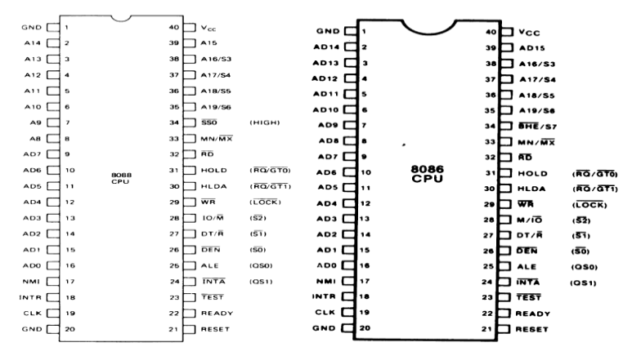
8088 and 8086 Microprocessors

Slide 5
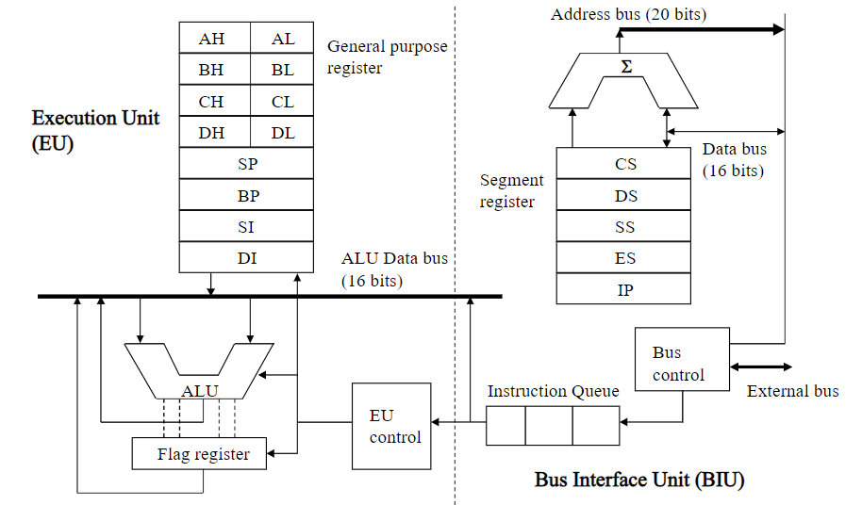
Architecture of 8088

Slide 6
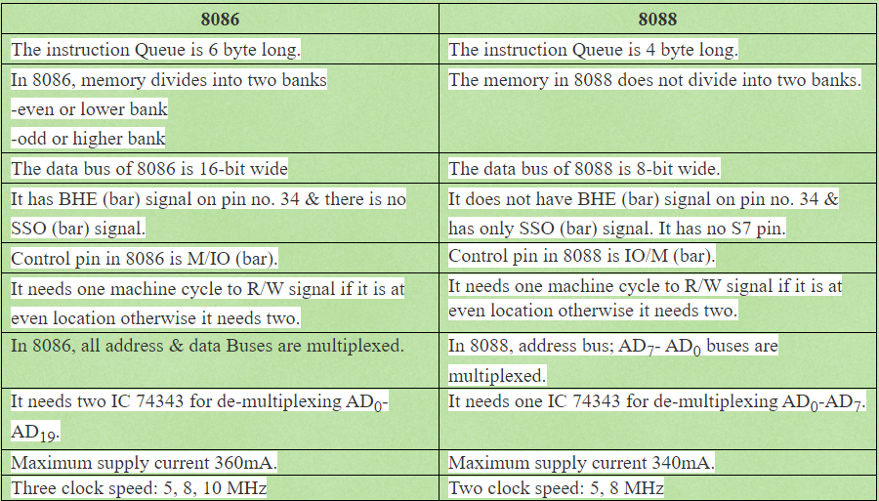
Differences between 8086 and 8088 Microprocessor

Slide 7
8088
The complete memory is homogeneously addressed as a bank of 1 Mbyte memory locations using the segmented memory scheme.
The 8088 can access only a byte at a time. This fact reduces the speed of operation of 8088 as compared to 8086.

Slide 8
References
Advanced Microprocessors and Peripherals by A K Ray & K M Bhurchandi
Microprocessors and Interfacing by Douglas V Hall & SSSP Rao

Slide 9

Thank You

